Slide 1
QuickForms Applications
Team Members
Dana Al-Rifai
Smita Borbaruah
Nadeen Kawash

Slide 2
Agenda
Overview
System Definition
Critical Scenario
Testing Strategies
Issue Tracking
Test Example
What’s Next

Slide 3
Overview
Client
Professor Liam Peyton
Application: QuickForms Application (PAL-IS, RPP)
Application using the QuickForms framework
Used in applications that use forms for data collection and report generation
Notes:
NADEEN
NEED TO OUTLINE CLIENT MORE AND CLIENTS ROLE IN THE QUICKFORMS APPS AND THEIR STAKE IN THE PROJECT
(our client develops tools using the Quickforms frameworks for hospitals, etc. )
Application:
A QuickForms application uses the QuickForms framework
This frameworkd is used in applications that use forms for data collection and report generation
Two examples of applications are PAL-IS and RPP.
PAL-IS is and RPP is
Problem?
Currently, these applications only provide the end user with the ability to enter data into forms and generate reports based on this data
Application users do not have the ability to make changes to forms on their own
This includes changes such as adding, deleting or editing options to drop down menus, changing labels, etc.
They must report back to our customer every time they need to make one of these changes which can be inconvenient for both the customer and the user
Solution: our generic capabilities

Slide 4
System Definition
Solution: add generic design capability that helps manage applications developed using QuickForms framework
Can be used to edit all different types of forms
Allow users makes changes to forms and profile settings on their own without having to report back to the customer
Notes:
Nadeen
It will allow user to make changes to form templates and profile settings on their own and will
This eliminates the need to report back to our customer (developer) any time a change is required.

Slide 5
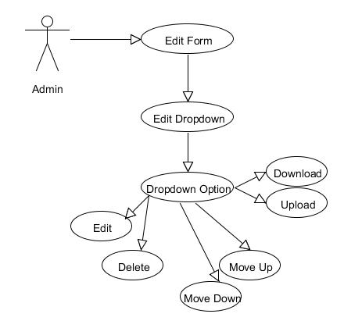
Critical Scenario
Notes:
nadeen

Slide 6
Critical Scenario
Main Use Case Example
UseCase: Edit Form
Pre-Conditions: The user is logged in as an admin
Procedure:
The user select a form to edit
The user clicks on “Design” button
The System displays the form in edit mode
Post Conditions: EditItem, CancelEdit
Notes:
Nadeen
Add use case image?

Slide 7
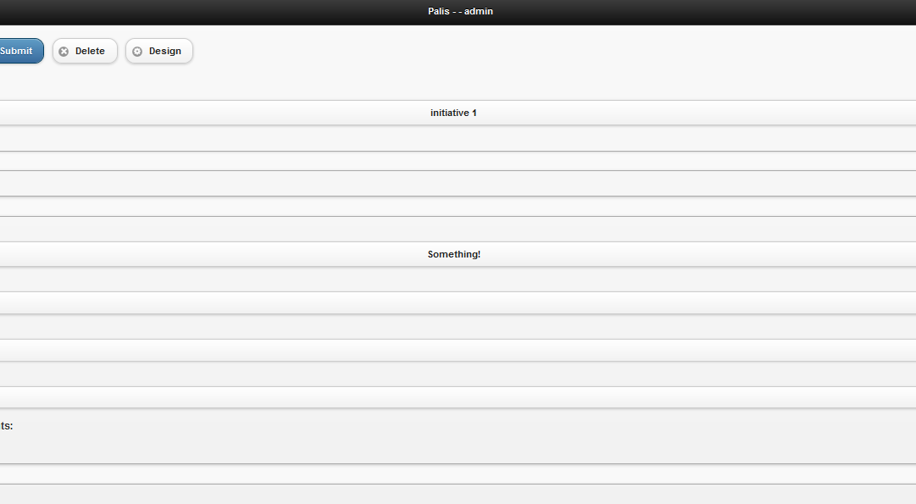
Use Case: EditForm
Notes:
Nadeen

Slide 8
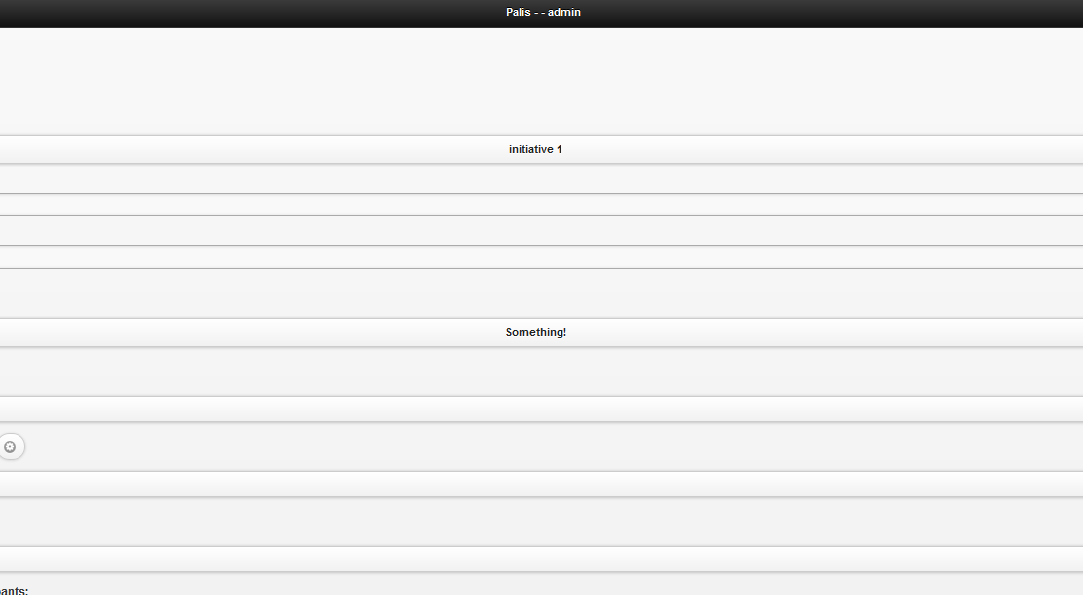
Use Case: EditForm
Notes:
Nadeen

Slide 9
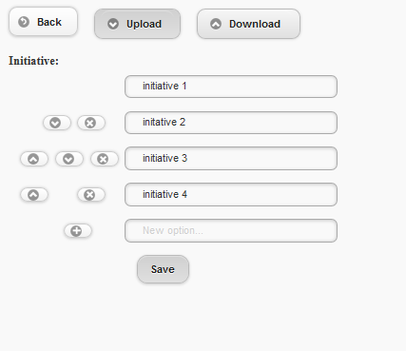
Use Case: EditForm
Notes:
Nadeen

Slide 10
Testing Strategy
Data-Driven Testing
Store test data
Input
Expected output
Actual output
Pass/Fail
In external storage (spreadsheet)
Run test and check for results
Web Application UI Checklist
Are all the field prompts spelt correctly?
Are fonts too large or too small to read?
Are names in command button & option box names are not abbreviations.
Notes:
Smita
Our overall testing strategy is based on data-driven testing
Where we store test data such as inputs, expected outputs, actual outputs in an external spread sheet. We then run the test and check the results to see if the test passes or fails.
To ensure that our User Interface is being generated correctly and is user-friendly, we also keep a UI checklist where keep track of data such as whether all the correct text is being generated and
whether font sizes are readable.

Slide 11
Tests
Unit Tests
Functional Tests
Acceptance Tests
Integration Tests
Notes:
Smita
More specifically our tests fall into one of four classes
Unit tests
Functional tests
Acceptance tests
Integration tests

Slide 12
Tests
Unit Tests
Mainly white-box tests
Used to test smaller units of code
QUnit framework
Functional Tests
Written before implementation of function
Black-box tests
Used to test larger components completed at end of each milestone
Notes:
Smita
We are using Unit Tests to tests smaller blocks of code. These tests are white-box tests that use the QUnit framework. This is a framework that can be used to test applications that use Jquery, jQuery ui and Jquery mobile, and also generic javascript code.
Our process follows the test-driven development process. Our functional tests are black-box tests written before the implementation of a function that we use to test larger components at the end of each milestone.

Slide 13
Tests
Acceptance Tests
Black-box tests that map to requirements
User-Acceptance tests on client side
Check whether requirement is met
Integration Tests
Testing whether our system builds correctly every time we integrate our work
Travis CI
Notes:
Our process follows the test-driven development process. Our functional tests are black-box tests written before the implementation of a function that we use to test larger components at the end of each milestone.
Our acceptance tests are black-box tests that map to requirements and indicate whether a requirement is met with a pass or fail. These will include the User-acceptance tests on the client side.
The Integration tests determine whether our system is building correctly every time we integrate our work.
We are using a service called Travis CI via github to continuously test the integration of our code.

Slide 14
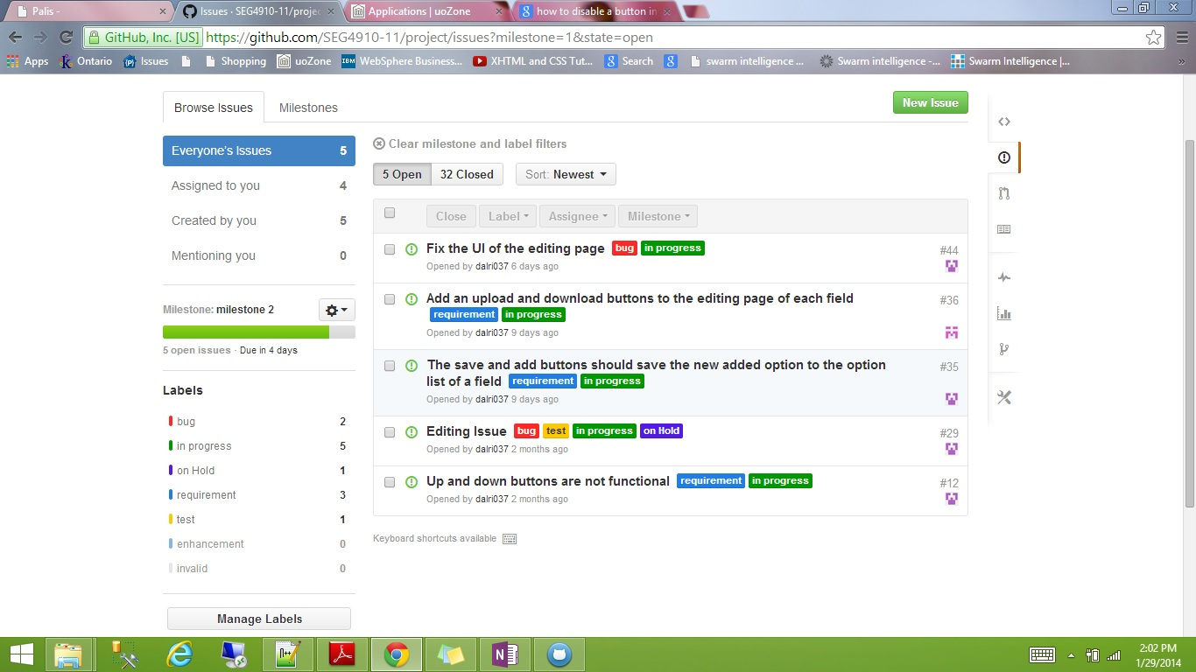
Issue Tracking
Notes:
nadeen

Slide 15
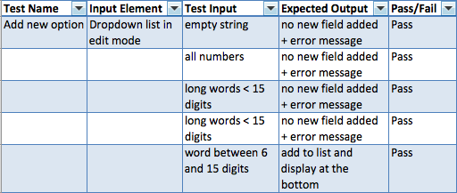
Test Example
Notes:
nadeen

Slide 16
Key Challenges
Coordinating group meetings
scheduling short, regular meetings throughout the week
long meetings during the weekend
Adapting to changes in requirements
changing milestone plans
change due date
discuss the new plan with the client based on the time left for development
Notes:
Smita
One of the challenges we faced, mainly during the previous semester was coordinating group meetings due to our conflicting schedules. However, this semester we have been able to improve upon this by scheduling short regular meetings thourhgout the week and longer meetings during the weekend as required.
A challenge we faced this semester was adapting to changes in some of the requirements of our project. To overcome this, we altered our project plan by changing our milestones and due dates and discussing our new plan with the client based on the time left for development.

Slide 17
Thank you
Questions?

Slide 18
What’s Next
Complete Testing
System Integration
Documentation

